Slide 1
Functions
Computer Science, Purdue University
Copyright McGraw Hill, Rosen, Discrete Mathematics and its Applications

Slide 2
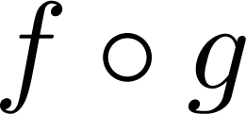
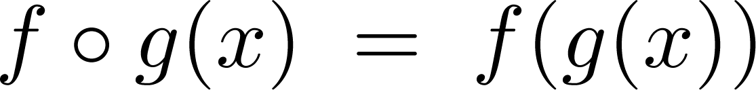
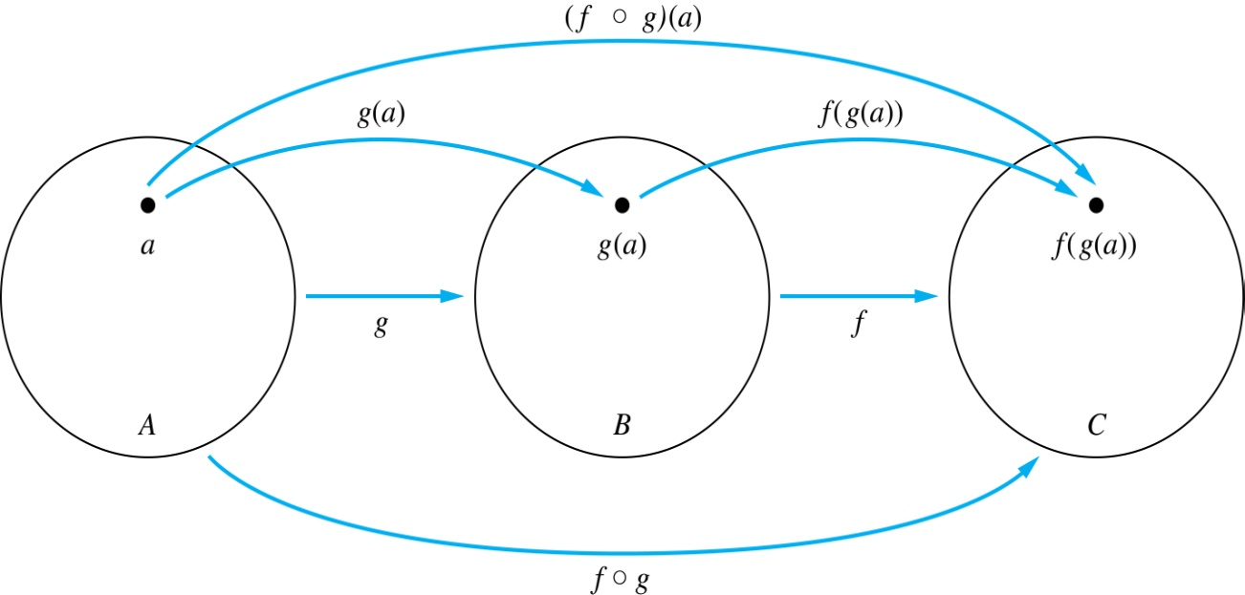
Functions
Composition of Functions
Definition: Let f: B → C, g: A → B. The composition of f with g, denoted is the function from A to C defined by
Computer Science, Purdue University

Slide 3
Functions
Composition of Functions
A
g
B
f
C
A
C
a
V
a
h
h
b
i
b
W
i
c
c
X
j
d
d
j
Y
Computer Science, Purdue University

Slide 4
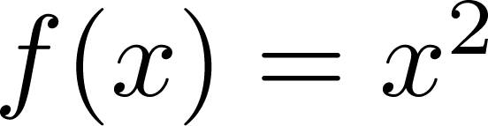
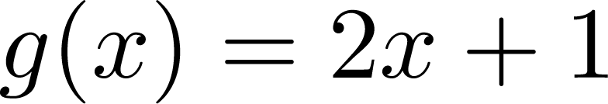
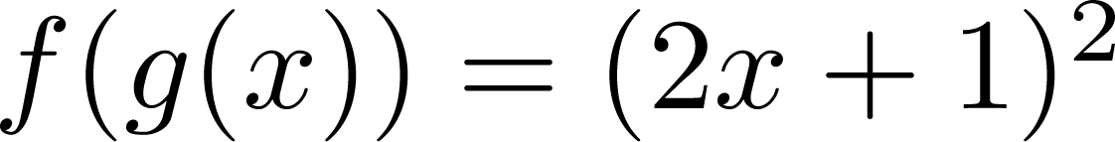
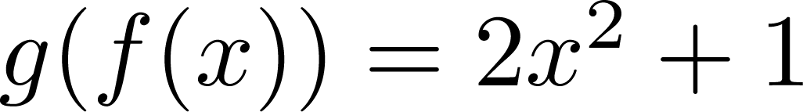
Functions
Composition of Functions
Example 1: If and , then
and
Computer Science, Purdue University

Slide 5
Functions
Composition of Functions
Example 2: Let g be the function from the set {a,b,c} to itself such that g(a) = b, g(b) = c, and g(c) = a. Let f be the function from the set {a,b,c} to the set {1,2,3} such that f(a) = 3, f(b) = 2, and f(c) = 1.
What is the composition of f and g, and what is the composition of g and f.
Solution: The composition f∘g is defined by
f∘g (a)= f(g(a)) = f(b) = 2.
f∘g (b)= f(g(b)) = f(c) = 1.
f∘g (c)= f(g(c)) = f(a) = 3.
Note that g∘f is not defined, because the range of f is not a subset of the domain of g.
Computer Science, Purdue University

Slide 6
Functions
Composition of Functions
Example 2: Let f and g be functions from the set of integers to the set of integers defined by f(x) = 2x + 3 and g(x) = 3x + 2.
What is the composition of f and g, and also the composition of g and f ?
Solution:
f∘g (x)= f(g(x)) = f(3x + 2) = 2(3x + 2) + 3 = 6x + 7
g∘f (x)= g(f(x)) = g(2x + 3) = 3(2x + 3) + 2 = 6x + 11
Computer Science, Purdue University

Slide 7
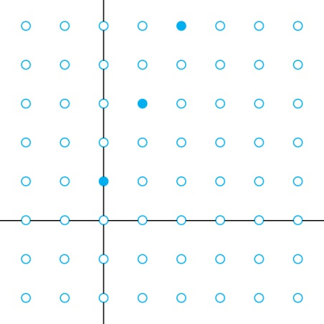
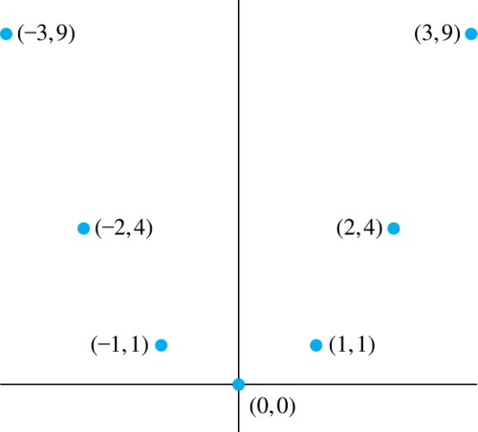
Functions
Graphs of Functions
Let f be a function from the set A to the set B. The graph of the function f is the set of ordered pairs {(a,b) | a ∈A and f(a) = b}.
Graph of f(n) = 2n + 1
from Z to Z
Graph of f(x) = x²
from Z to Z
Computer Science, Purdue University

Slide 8
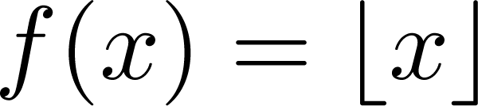
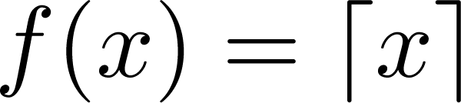
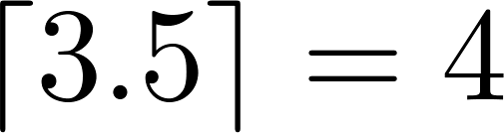
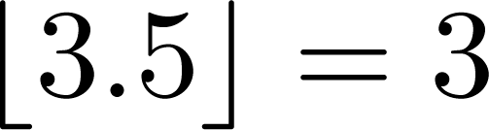
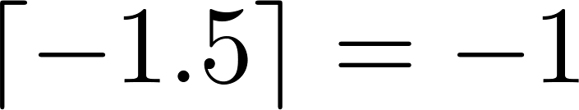
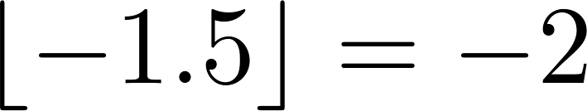
Functions
Some Important Functions
The floor function, denoted
is the largest integer less than or equal to x.
The ceiling function, denoted
is the smallest integer greater than or equal to x
Example:
Computer Science, Purdue University

Slide 9
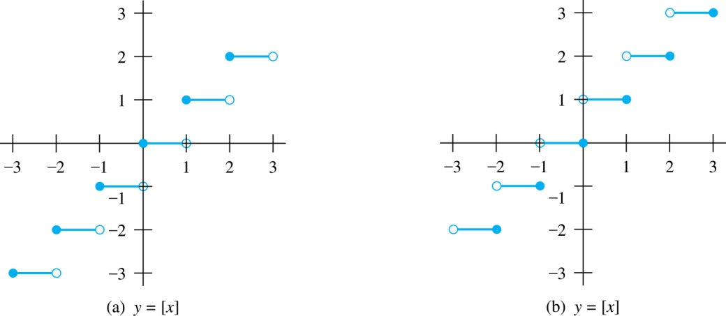
Functions
Floor and Ceiling Functions
Graph of (a) Floor and (b) Ceiling Functions
Computer Science, Purdue University

Slide 10
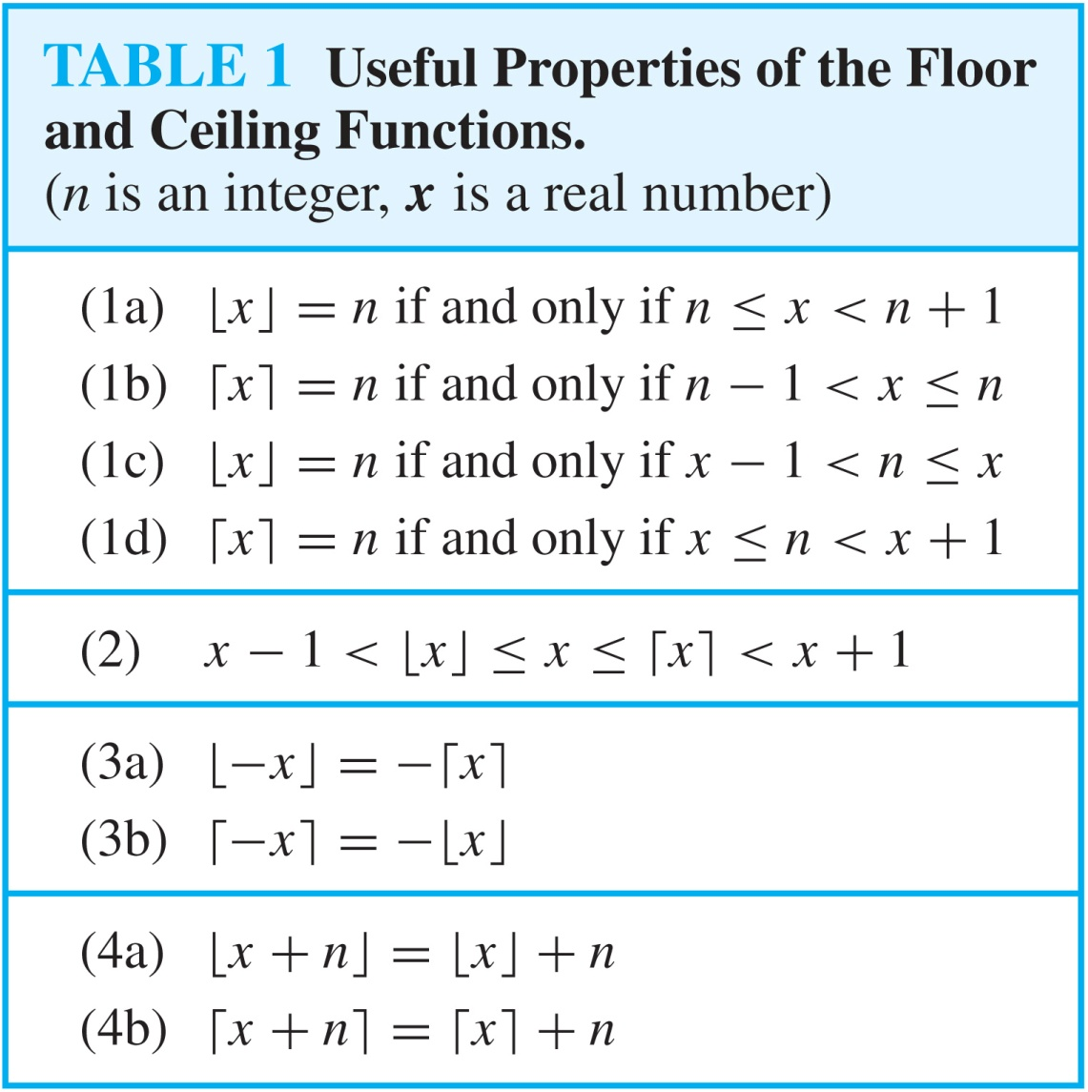
Functions
Floor and Ceiling Functions
Computer Science, Purdue University

Slide 11
Functions
Proving Properties of Functions
Example: Prove that x is a real number, then
⌊2x⌋= ⌊x⌋ + ⌊x + 1/2⌋
Solution: Let x = n + ε, where n is an integer and 0 ≤ ε< 1.
Case 1: ε < ½
2x = 2n + 2ε and ⌊2x⌋ = 2n, since 0 ≤ 2ε< 1.
⌊x + 1/2⌋ = n, since x + ½ = n + (1/2 + ε ) and 0 ≤ ½ +ε < 1.
Hence, ⌊2x⌋ = 2n and ⌊x⌋ + ⌊x + 1/2⌋ = n + n = 2n.
Case 2: ε ≥ ½
2x = 2n + 2ε = (2n + 1) +(2ε − 1) and ⌊2x⌋ =2n + 1, since 0 ≤ 2 ε - 1< 1.
⌊x + 1/2⌋ = ⌊ n + (1/2 + ε)⌋ = ⌊ n + 1 + (ε – 1/2)⌋ = n + 1 since 0 ≤ ε – 1/2< 1.
Hence, ⌊2x⌋ = 2n + 1 and ⌊x⌋ + ⌊x + 1/2⌋ = n + (n + 1) = 2n + 1.
Computer Science, Purdue University

Slide 12
Functions
Factorial Function
Definition: f: N → Z⁺ , denoted by f(n) = n! is the product of the first n positive integers when n is a nonnegative integer.
f(n) = 1 ∙ 2 ∙∙∙ (n – 1) ∙ n, f(0) = 0! = 1
Examples:
f(1) = 1! = 1
f(2) = 2! = 1 ∙ 2 = 2
f(6) = 6! = 1 ∙ 2 ∙ 3∙ 4∙ 5 ∙ 6 = 720
f(20) = 2,432,902,008,176,640,000.
Computer Science, Purdue University

Slide 13
Thank You

